Slide 1

Low Stock Email Alert System
Introducing our Smart Inventory Management System, featuring automated email notifications to streamline your stock control processes. This innovative solution ensures you're always informed and ready to act.

Slide 2

The Challenge: Overcoming Manual Inventory Hurdles
Inefficient Manual Monitoring
Risk of Stock-Out Situations
Without real-time oversight, businesses face the constant threat of running out of popular items, leading to lost sales and customer dissatisfaction.
Reliance on manual checks leads to time-consuming processes and increased labor costs, diverting valuable resources from other critical tasks.
Delayed Decision-Making
Slow identification of low stock levels results in delayed reordering, impacting supply chain efficiency and overall operational agility.

Slide 3
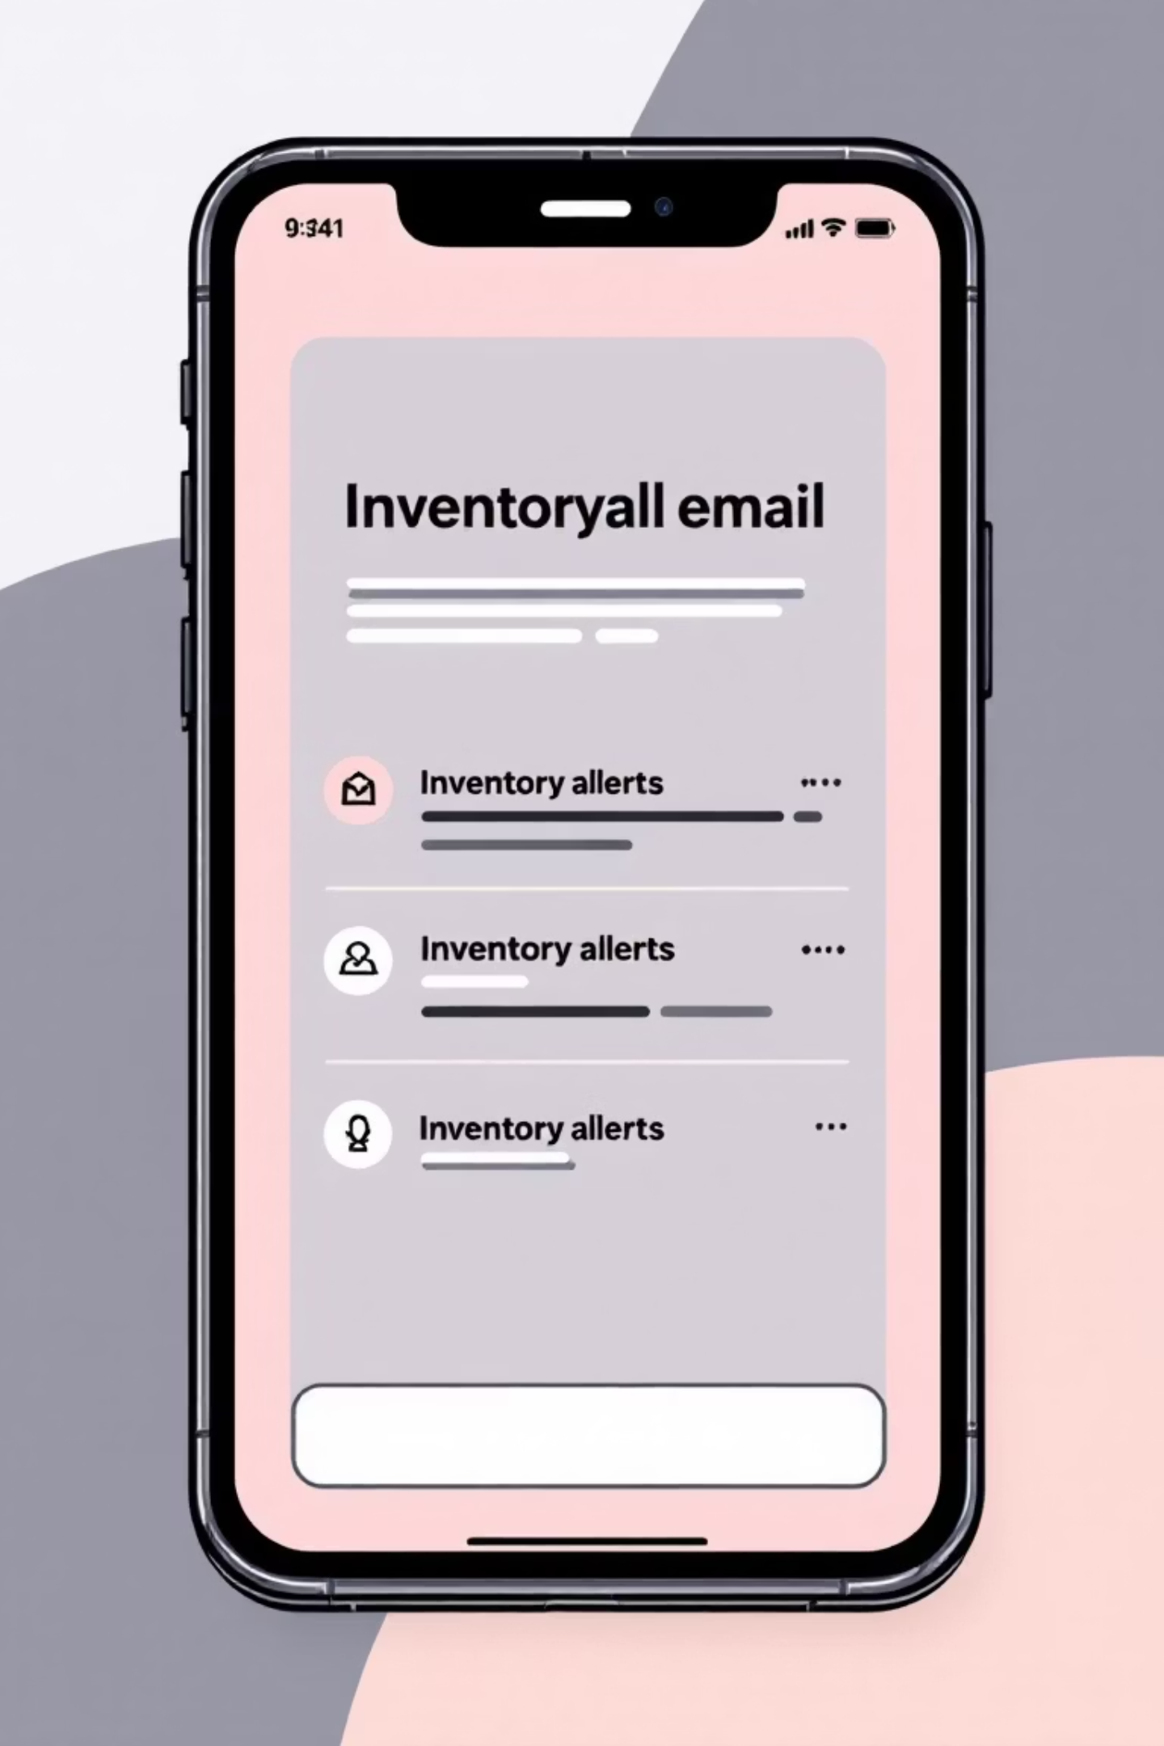



Our Solution: Intelligent Inventory Alerts
Automated Low Stock Detection
Our system continuously monitors inventory levels, automatically identifying when stock falls below predefined thresholds without human intervention.
Targeted Email Alerts
Immediate notifications are sent directly to store managers, providing them with timely information to prevent stock shortages.
Real-Time Notification System
Receive instant updates, enabling proactive inventory management and rapid response to changing stock conditions.

Slide 4





Robust System Architecture
Our alert system is built on a modern, scalable architecture designed for reliability and performance.
Django REST API
MySQL Database
Provides a secure and efficient interface for all inventory data interactions.
Stores all product, stock, and user data securely and ensures data integrity.
JWT Authentication
SMTP Email Service
Secures API endpoints, ensuring only authorized users can access and modify inventory information.
Utilizes secure SMTP protocols for reliable and timely email alert delivery.

Slide 5

Intelligent Low Stock Detection
Our system incorporates a precise logic to identify low stock levels effectively, ensuring accuracy and flexibility.
Threshold Comparison: The system constantly compares current stock quantities against a predetermined low-stock threshold set for each product.
API-Triggered Checks: Low stock checks are primarily triggered via dedicated API calls, allowing for integration with various inventory updates.
Configurable Thresholds: Store managers can easily adjust the low-stock threshold for individual products, adapting to seasonal demands or specific operational needs.

Slide 6

Seamless Email Alert Workflow
Once low stock is detected, a streamlined process ensures that alerts are generated and dispatched promptly to the relevant personnel.
01
02
Low Stock Detected
Email Content Generation
The system identifies inventory levels falling below the configured threshold.
A detailed email is automatically composed, including product details, current stock, and reorder recommendations.
03
Email Sent via Django SMTP
The prepared email is securely sent to the designated store managers using Django's built-in SMTP capabilities.

Slide 7

Secure Email Configuration with Gmail
We leverage Gmail's robust SMTP service to ensure reliable and secure email delivery for our low stock alerts.
SMTP Integration
Secure App Password
Environment Variables
Our system connects to Gmail's SMTP servers using secure protocols for outgoing email.
Instead of your primary Gmail password, we use an App Password for enhanced security.
All sensitive credentials are stored as environment variables, keeping them out of the codebase.

Slide 8


Demonstration Flow
Let's walk through a quick demonstration to see the alert system in action.
Add Stock in Admin
Begin by adding a new product or increasing the quantity of an existing one via the admin panel.
Reduce Quantity Below Threshold
Simulate sales or inventory adjustments to bring the product's quantity below its predefined low-stock threshold.
Call Low Stock API
Trigger the low stock detection mechanism by making an API call, mimicking a real-world inventory update.
Receive Email Alert
Observe the instant email notification arriving in the store manager's inbox, detailing the low stock item.

Slide 9

Key Benefits of the System
Prevents Stock-Outs
Ensure continuous product availability, leading to uninterrupted sales and enhanced customer satisfaction.
Improves Operational Efficiency
Automates manual tasks, allowing staff to focus on more strategic activities and reduce operational costs.
Provides Real-Time Alerts
Empower quick decision-making with immediate notifications on critical inventory changes.
Offers a Scalable Solution
Designed to grow with your business, easily accommodating increasing product volumes and store locations.

Slide 10

Conclusion: Towards Smarter Inventory Control
This automated low stock email alert system significantly enhances inventory management, providing store managers and backend engineers with the tools needed for optimal stock control.
Ready for Production
Seamless Frontend Integration
The system is fully developed, tested, and ready for deployment into a production environment.
The API-driven architecture ensures easy integration with existing or future frontend applications.
We are confident this solution will be a valuable asset for your inventory operations.

